Slide 1
AI ENGINEERING BOOTCAMP AI & Data ST ML & AI Engineering
Week 1, Day 1
Recommended External Resources

Slide 2
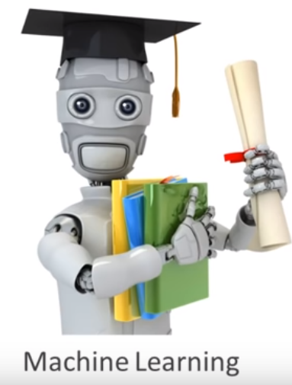
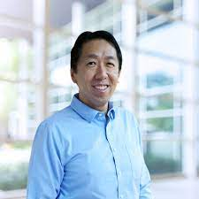

Machine Learning | Andrew Ng |Stanford University
Andrew Ng is a British-born American computer scientist and technology entrepreneur focusing on machine learning and AI.^{[2]} Ng was a co-founder and head of Google Brain and was the former chief scientist at Baidu, building the company's Artificial Intelligence Group into a team of several thousand people.^{[3]}
Ng is an adjunct professor at Stanford University (formerly associate professor and Director of its Stanford AI Lab or SAIL). Also a pioneer in online education, Ng co-founded Coursera and deeplearning.ai
https://www.deeplearning.ai/
©TSI

Slide 3
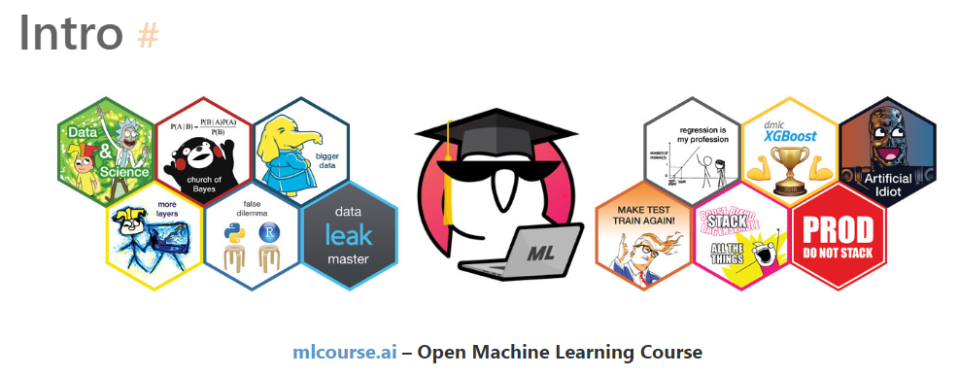

Kaggle.com
https://mlcourse.ai/book/index.html
https://www.kaggle.com/learn

Slide 4
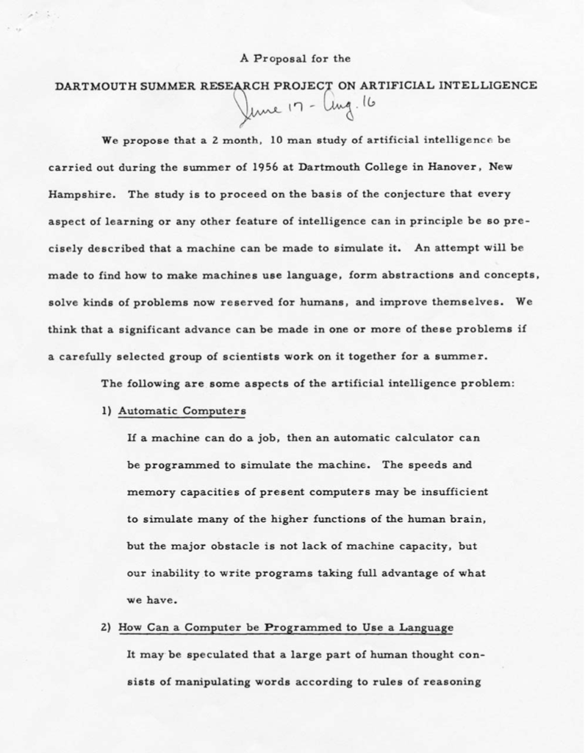
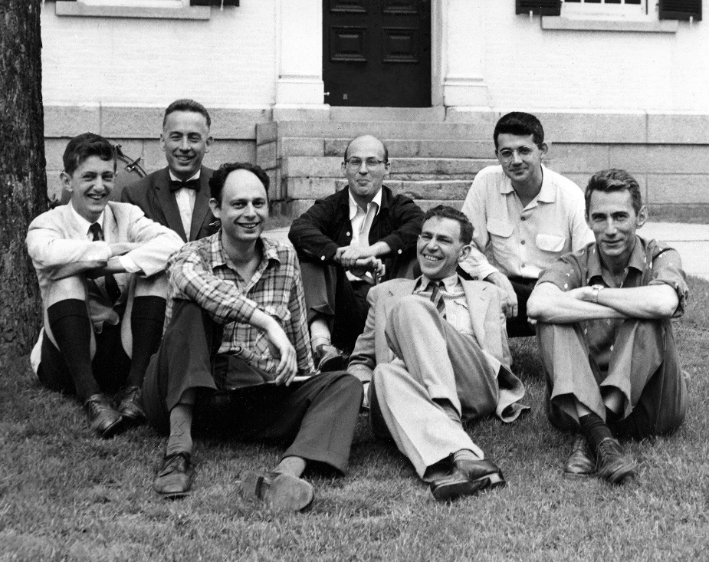
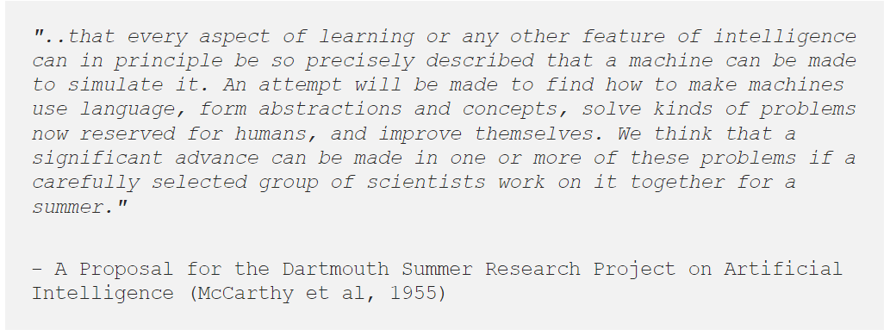
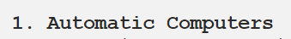
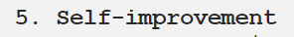
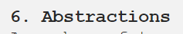
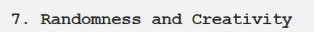
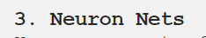
The Birthplace of AI The 1956 Dartmouth Workshop
Left: Marvin Minsky, Claude Shannon, Ray Solomonoff and other scientists at the Dartmouth Summer Research Project on Artificial Intelligence (Photo: Margaret Minsky). Right: A Proposal for the Dartmouth Summer Research Project on Artificial Intelligence (1955)
https://www.cantorsparadise.com/the-birthplace-of-ai-9ab7d4e5fb00

Slide 5
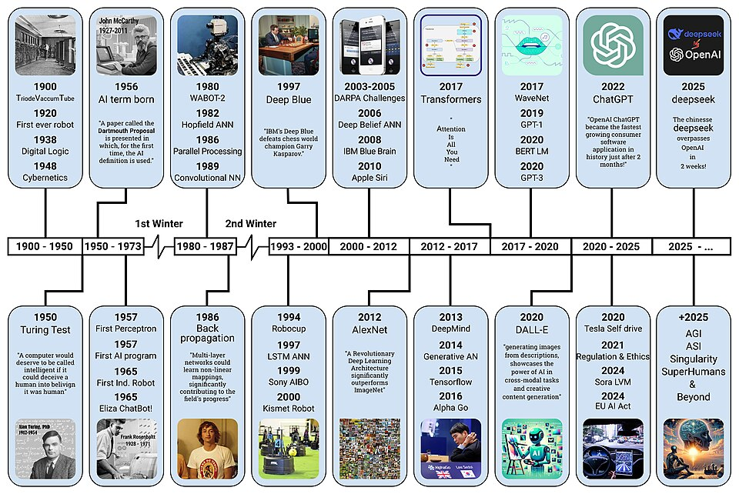
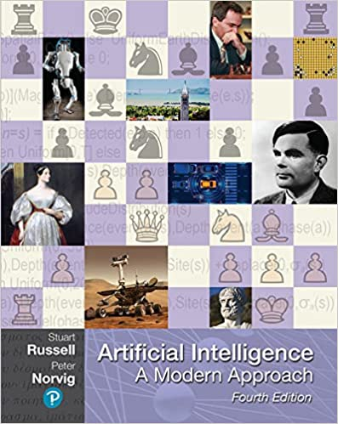
History of AI
More information you might find here
http://aima.cs.berkeley.edu/
https://commons.wikimedia.org/wiki/File:AI-History-Timeline-300dpi.jpg#Summary

Slide 6
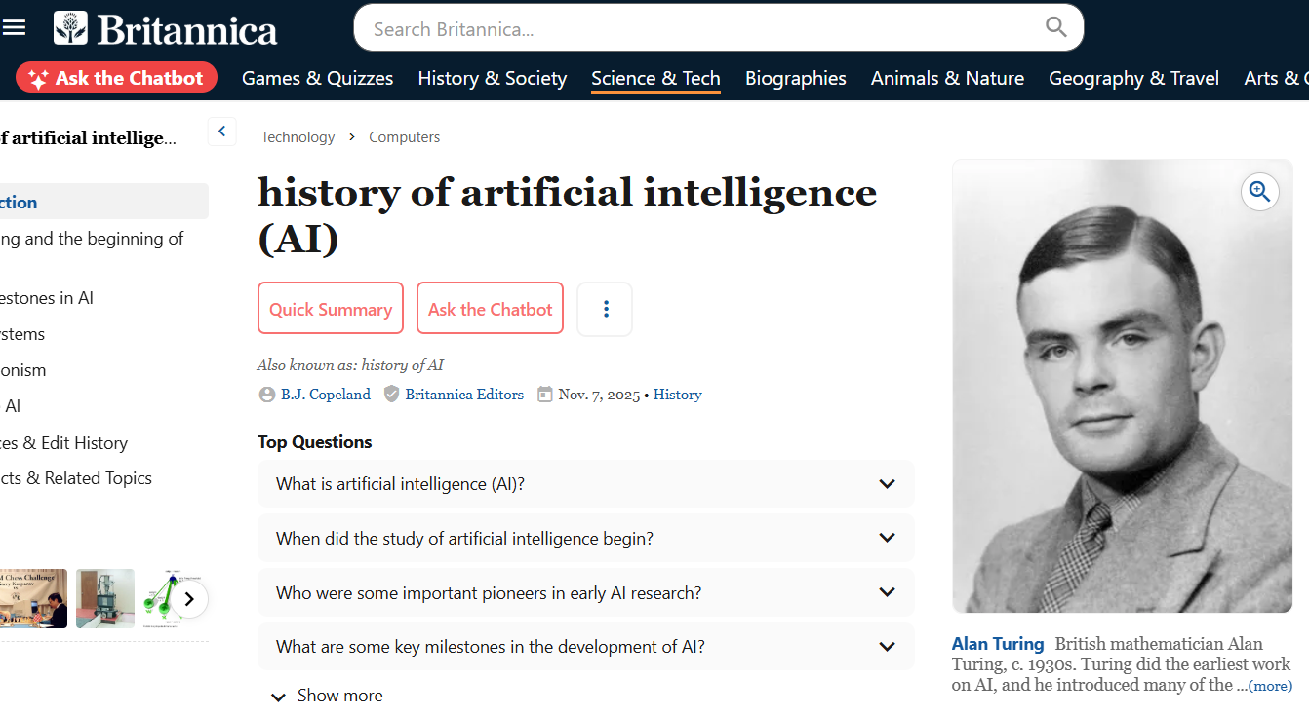
More information
https://www.britannica.com/science/history-of-artificial-intelligence/Connectionism

Slide 7
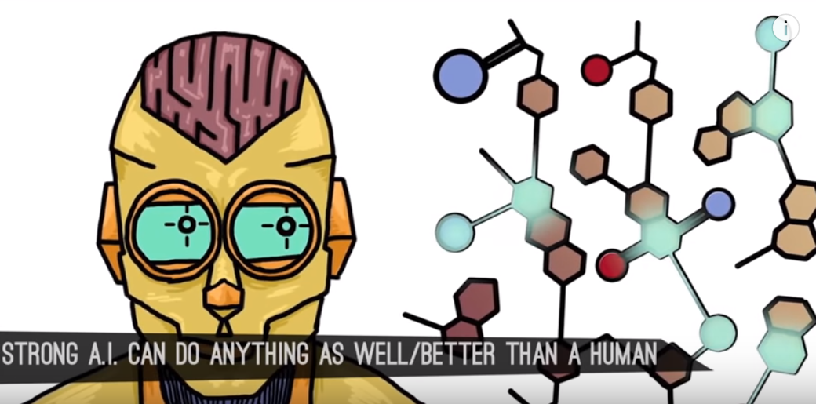
What Exactly is Artificial Intelligence?
https://www.youtube.com/watch?v=kWmX3pd1f10

Slide 8
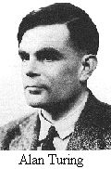
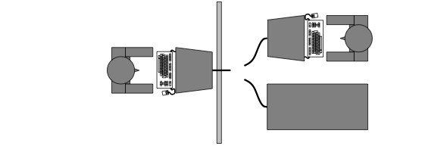
Turing test
Turing (1950) Computing Machinery and Intelligence
Operational intelligence test:
Games simulation
The test is still relative, as there may be erroneous questions.
Requires the interaction of the main components of AI: knowledge, reasoning, language understanding, learning, …
paper

Slide 9

Kinds of ML
https://medium.com/@aditya.yadav/millennium-breakthrough-automatski-announces-the-general-availability-of-universal-6b8d33bee3ce

Slide 10
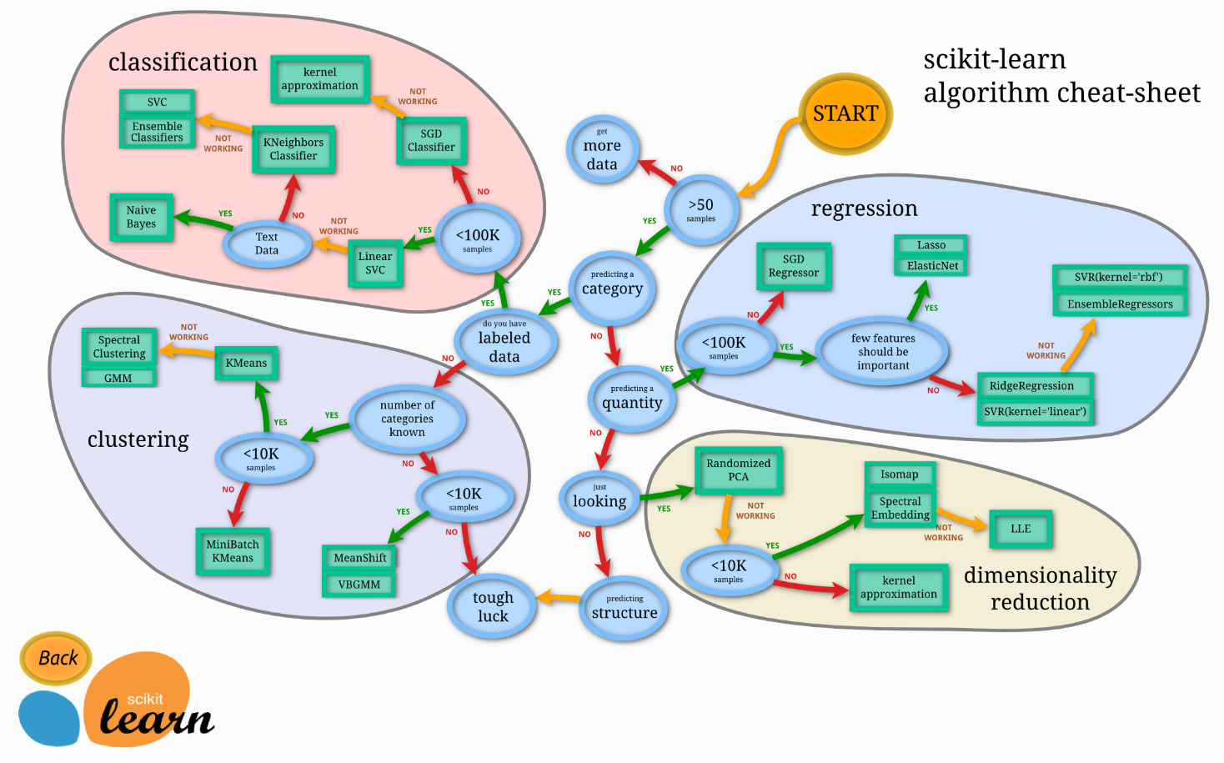
ML – TOOL FOCUS
http://scikit-learn.org/stable/tutorial/machine_learning_map/index.html

Slide 11

https://vas3k.com/blog/machine_learning/?fbclid=IwAR0NjjOJlZt4-KiaBGi11DskcBHAa2d6xaUchkPZdDch7pxS5sbcrZkUBJA

Slide 12
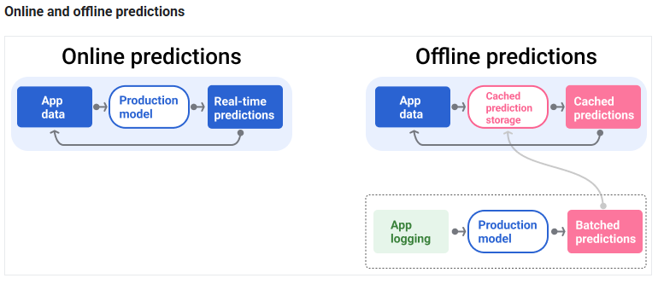
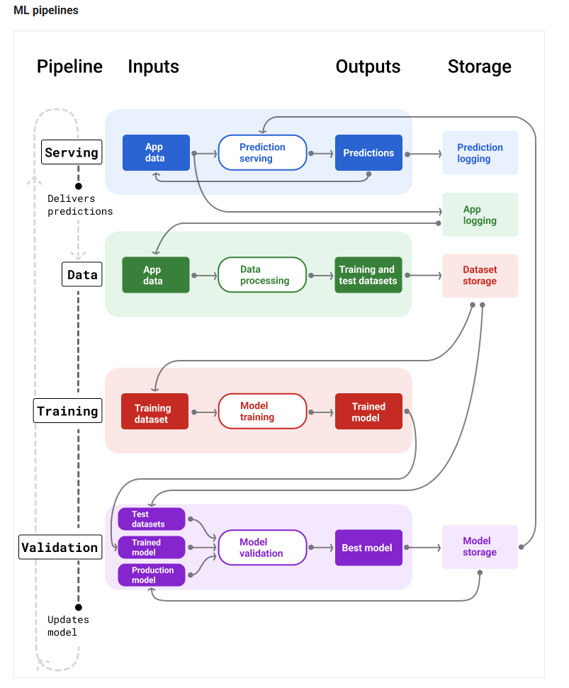
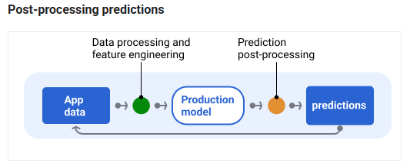
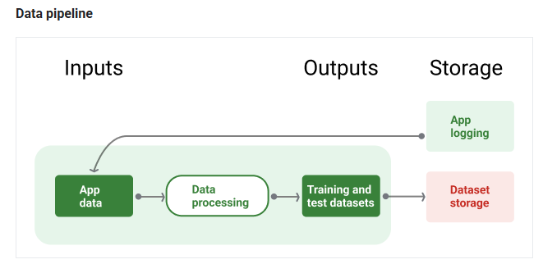
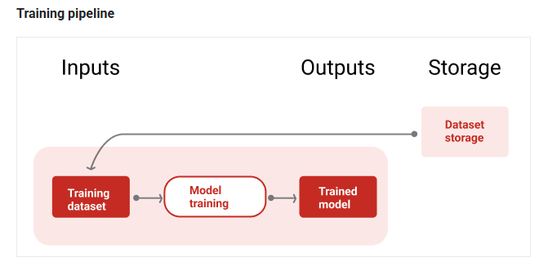
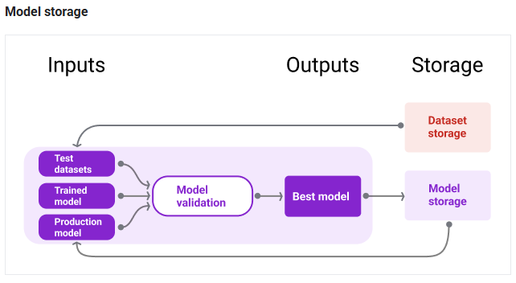
ML PIPELINES
https://developers.google.com/machine-learning/managing-ml-projects/pipelines

Slide 13
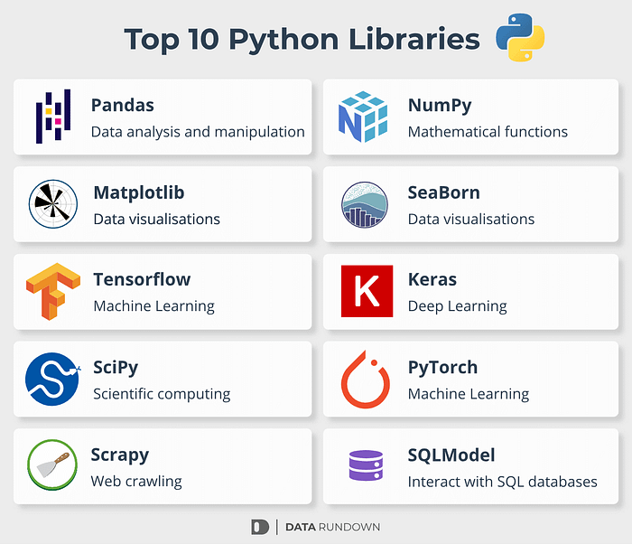
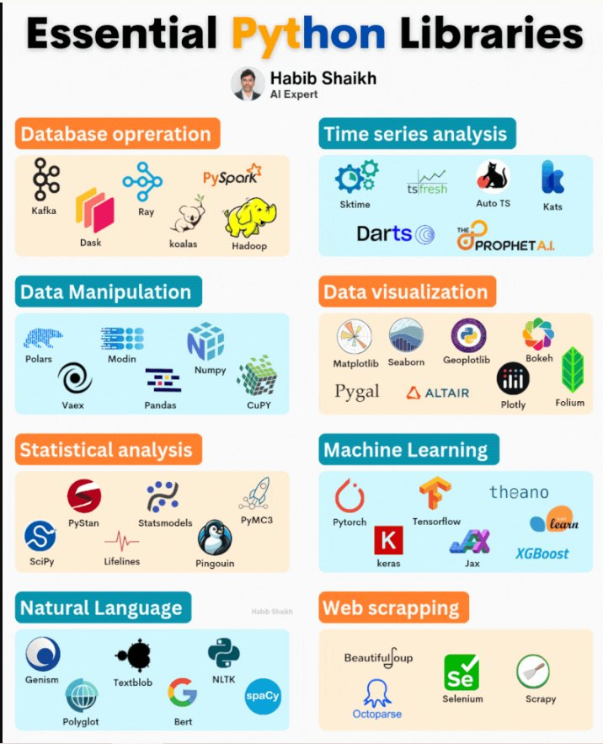

Common libraries
Scikit-learn is a Python library that provides tools for data mining and machine learning. It includes a variety of algorithms for classification, regression, clustering, and more.

